Slide 1

Healthcare
Persistency of a Drug
12th May 2023

Slide 2
Group Name: One
Name: Hira Fahim
Email: hirashahidd26@yahoo.com
Country: United Kingdom
Company: Unemployed
Specialization: Data Science
Batch Code: LISUM19
Submission Date: 12th May 2023
Submitted to: Data Glacier

Slide 3
Background – Healthcare – Persistency of the Drug
Problem Statement:
One of the challenge for all Pharmaceutical companies is to understand the persistency of drug as per the physician prescription. To solve this problem ABC pharma company approached an analytics company to automate this process of identification.
ML Problem:
With an objective to gather insights on the factors that are impacting the persistency, build a classification for the given dataset.
Hira Fahim

Slide 4
Approach
The analysis has been divided into following parts:
Data Understanding
Exploratory Data Analysis
Univariate Analysis
Bivariate Analysis
Feature Engineering
Feature Selection
Model Building
Model Evaluation
Model Selection
Model Deployment
Hira Fahim

Slide 5
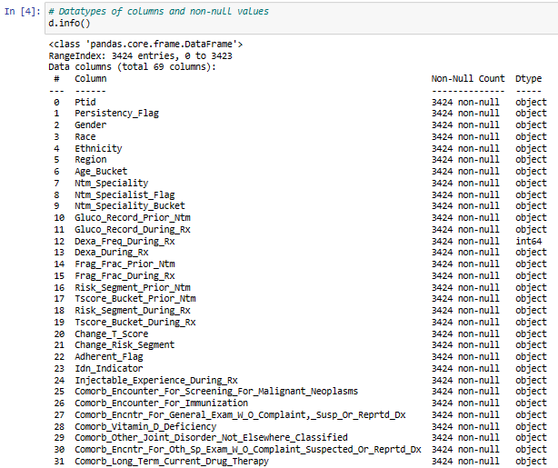
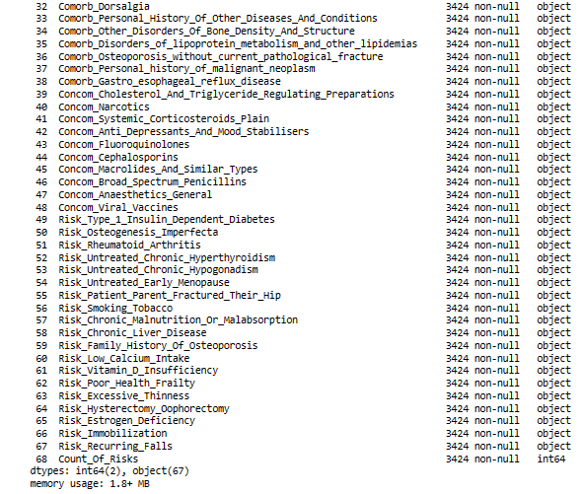
Data Understanding
Dataset Information
The data is related to Pharmaceutical companies and to understand the persistency of drug as per the physician prescription. The dataset is based on demographic details of patients, provider attributes, clinical factors and disease and treatment factors.
Datatype of columns and Non-Null values
Hira Fahim

Slide 6
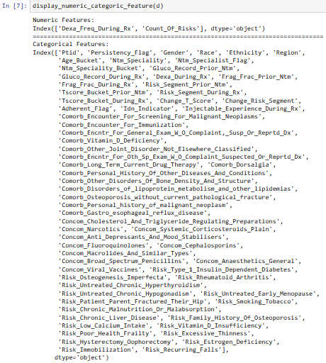
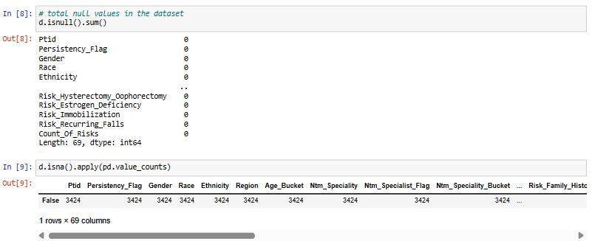
Data Understanding
Numerical and Categorical Features
Null values
There is no null values in the dataset.
Hira Fahim

Slide 7
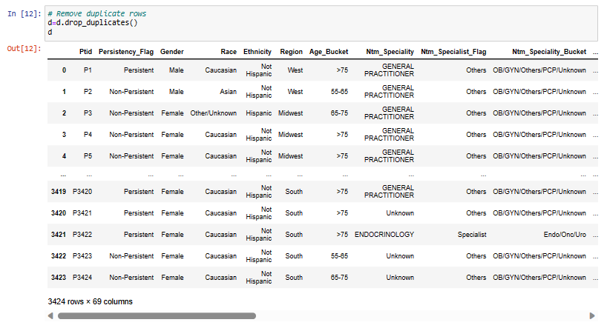

Exploratory Data Analysis
Step:1 Drop Duplicate Rows
Step:2 Drop Unnecessary Column
‘Ptid’ has all unique values .
There is no duplicate rows in the dataset.
Hira Fahim

Slide 8
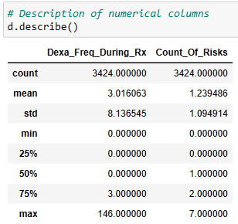
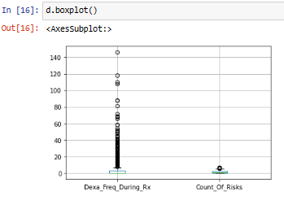
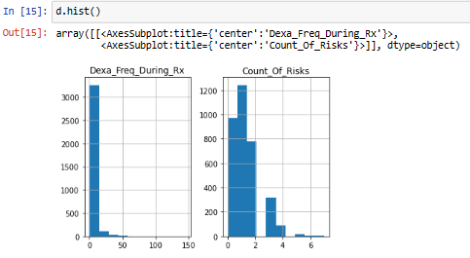
Univariate Analysis
Description of the data
Visualization (boxplot) of Numerical Attributes
Histogram for Numerical Attributes
From description and boxplot, we can see there are outliers in numerical input variables. Histogram shows uneven distribution and positively skewed data in both numerical variables.
Hira Fahim

Slide 9
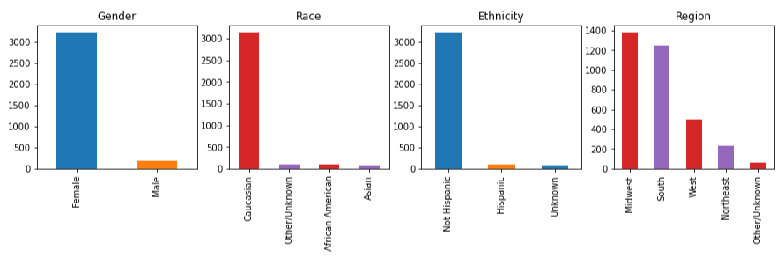
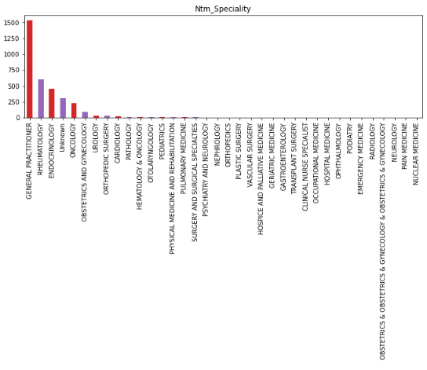
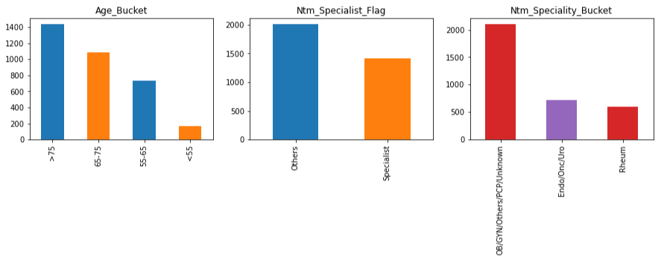
Univariate Analysis
Visualization of Categorical Attributes
In Bar chart of categorical columns, we see uneven distribution of data in all the categorical columns.
Hira Fahim

Slide 10
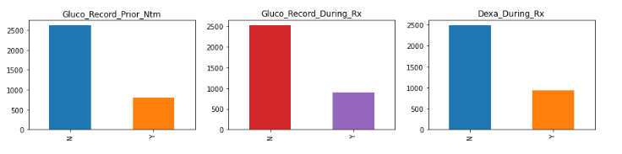
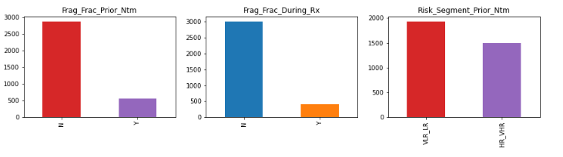
Univariate Analysis
Visualization of Categorical Attributes
In Bar chart of categorical columns, we see uneven distribution of data in all the categorical columns.
Hira Fahim

Slide 11
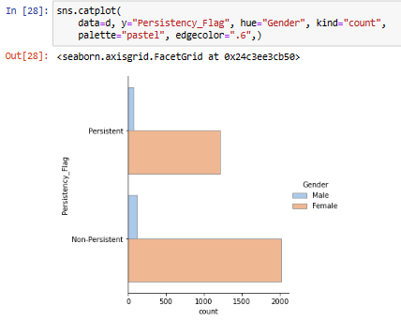
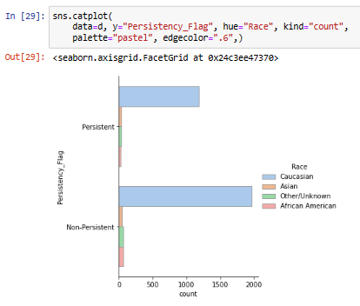
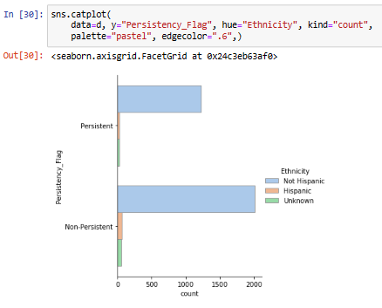
Bivariate Analysis
Persistency of the drug based on Gender
Persistency of the drug based on Race
Persistency of the drug based on Ethnicity
There is no significant insight through bivariate Analysis.
Hira Fahim

Slide 12
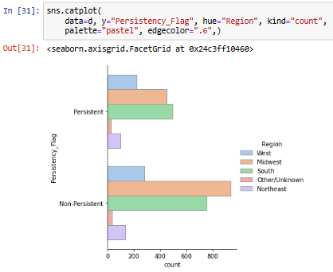
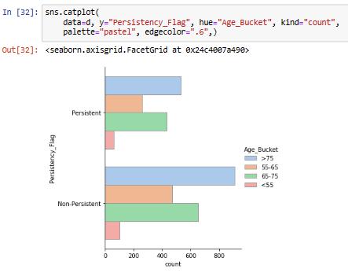
Bivariate Analysis
Persistency of the drug based on Region
Persistency of the drug based on Age
There is no significant insight through bivariate Analysis.
Hira Fahim

Slide 13

Feature Engineering
Convert datatype of Categorical Features
Encode Categorical Columns into Numerical
Hira Fahim

Slide 14
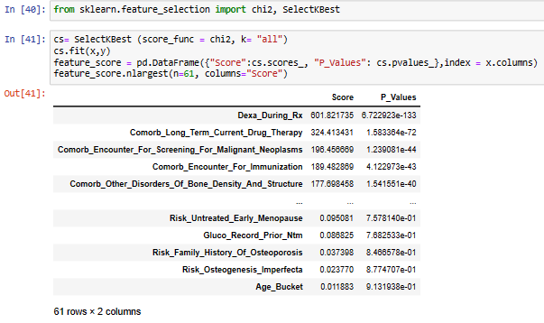
Feature Selection
Divide independent variables and target variable
Categorical Feature Selection using sklearn library and chi2 and SelectKbest function.
Hira Fahim

Slide 15
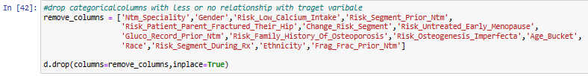
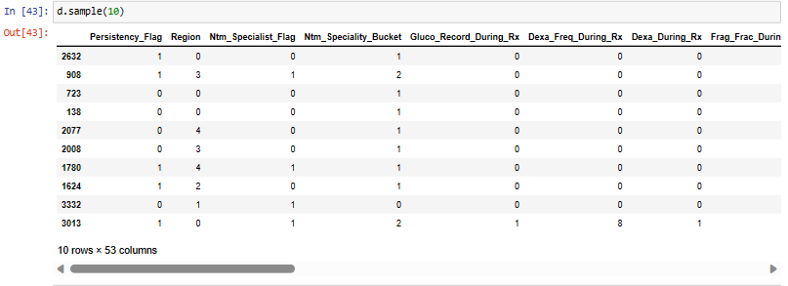
Feature Selection
Eliminate Categorical features with less or no relationship with target variable considering the p-value> 0.05
Final dataset ready for Modelling
Hira Fahim

Slide 16
Model Building
The dataset is imbalance, so we will balance the dataset using SMOTE.
Divide the dataset into input variables and output variable then split the input and output into train and test sets (20% test and 80% train).
Different Machine Learning models to predict the persistency of the drug:
Logistic Regression
Random Forest
K- Nearest Neighbor
Gradient Boosting
Hira Fahim

Slide 17
Model Evaluation
Metrics of Evaluation
Accuracy, Precision, Recall and F1-Score
Scores of Test, Train and Complete dataset
Confusion Matrix
Lift and Gain
KS Statistics and ROC-AUC Score
Hira Fahim

Slide 18
Model Selection
Model selection based on Scores and Confusion Matrix
Model | Score All Dataset | Score Train Dataset | Score Test Dataset | TN | FP | FN | TP
Logistic Regression | 0.8022 | 0.785 | 0.774 | 335 | 83 | 110 | 326
Random Forest | 0.8028 | 0.768 | 0.752 | 369 | 49 | 163 | 273
KNNC | 0.837 | 0.8635 | 0.787 | 332 | 86 | 96 | 340
KNNC + Hyperparameter Tuning | 0.837 | 0.863 | 0.787 | 332 | 86 | 96 | 340
Gradient Boosting | 0.857 | 0.868 | 0.77 | 333 | 85 | 111 | 325
Gradient Boosting + Hyperparameter Tuning | 0.943 | 0.962 | 0.803 | 343 | 75 | 93 | 343
The highest score for all dataset is of Gradient Boosting with hyperparameter tuning. But the difference between the score train dataset and test dataset is 16% which means its over fitting model. For the persistency of the drug the FN can cost a lot to the healthcare business, so it is needed to be low. KNNC and KNNC with hyperparameter tuning have low FN. KNNC is the best model. Let’s check other metrics for evaluation.
Hira Fahim

Slide 19
Model Selection
Model selection based on Lift and Gain Curve
Cumulative gains and lift charts are visual aids for measuring model performance.
The Greater the area between the Lift / Gain and Baseline, the Better the model.
By analysing Gain and Lift Curve, Random Forest Classification Model, KNNC model and Gradient Boosting Classification model with Hyperparameter Tuning are the best models.
Hira Fahim

Slide 20
Model Selection
Model selection based on Accuracy, Precision, Recall, F1 Score, KS statistics and AUC-ROC
Model | Precision | Recall | F1 score | Accuracy | KS Statics | AUC- ROC
Logistic Regression | 0 - 0.75 1 - 0.80 | 0.80 0.75 | 0.78 0.77 | 0.77 | 0.565 | 0.85
Random Forest | 0 – 0.69 1 – 0.85 | 0.88 0.63 | 0.78 0.72 | 0.75 | 0.556 | 0.844
KNNC | 0 – 0.78 1 – 0.80 | 0.79 0.78 | 0.78 0.79 | 0.79 | 0.574 | 0.85
KNNC + Hyperparameter Tuning | 0 – 0.78 1 – 0.80 | 0.79 0.78 | 0.78 0.79 | 0.79 | 0.574 | 0.85
The F1- Score, KS statistics and AUC-ROC metrics of KNNC model are the best. Therefore, The best model for deployment is K- Nearest Neighbor Classification model.
Hira Fahim

Slide 21
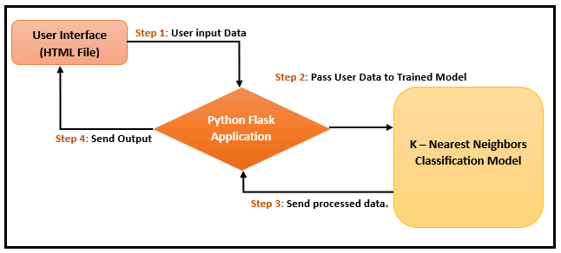
Model Deployment
Given Workflow shows K- Nearest Neighbors Classifier model is used and Flask Framework for deployment. It represents the details of how the model works from user interface till the results.
Hira Fahim

Slide 22
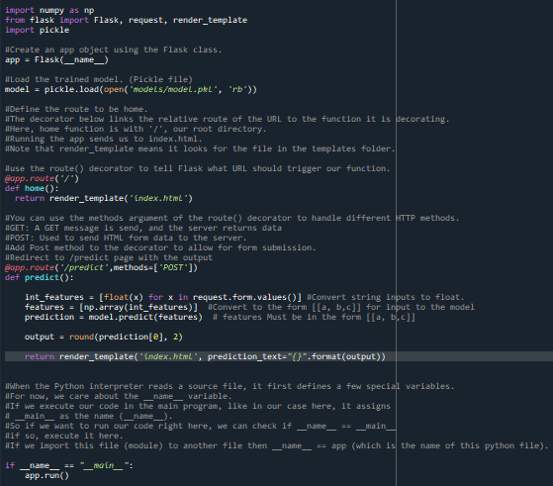
Model Deployment
Save the model using Pickle.
Deploy the model using Flask framework.
The app.py file contains the source code including the ML code for prediction and will be execute by the Python interpreter to run the Flask web application.
The Index.html file will render a text form where a user enter the details of required fields. Index.html file will be rendered via the render_template ('index.html', prediction_text="{}".format(output)), which is inside the predict function of app.py script to display the output as per the input submitted by the user.
The URL generate by ‘app.py.’ Open a web browser and navigate to http://127.0.0.1:5000/ following is output of Index.html.
Hira Fahim

Slide 23
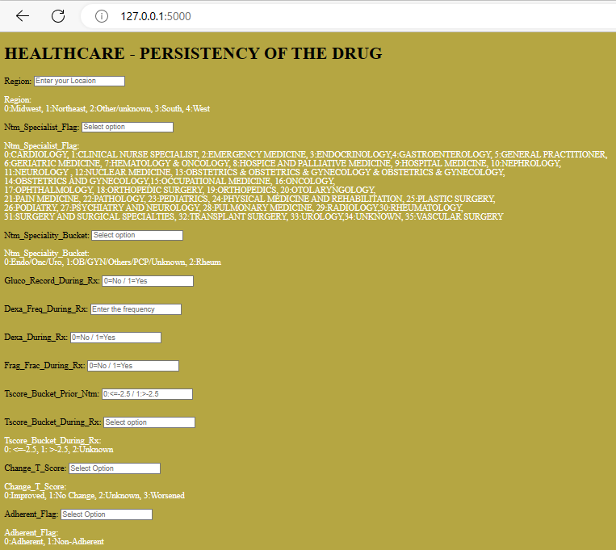
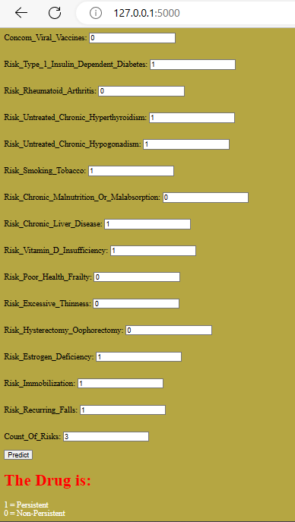
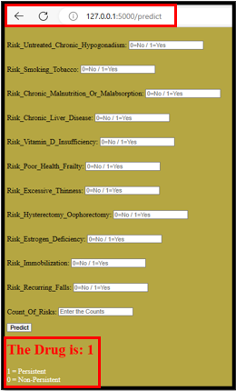
Model Deployment
Select categorical fields as per their respective number in the given code and click the Predict button. The predicted result will be displayed at the bottom of the web page.
Hira Fahim

Slide 24
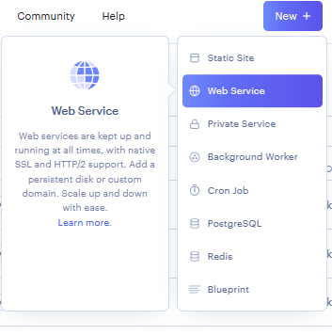
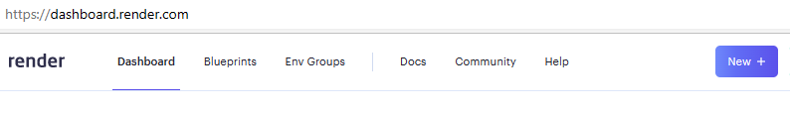
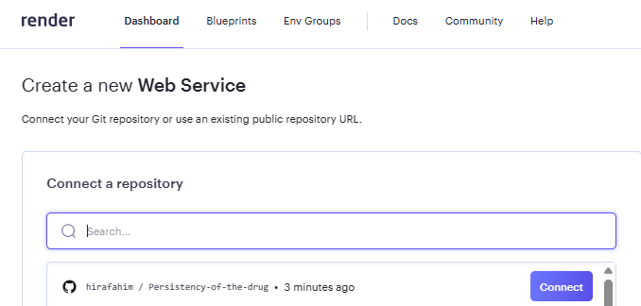
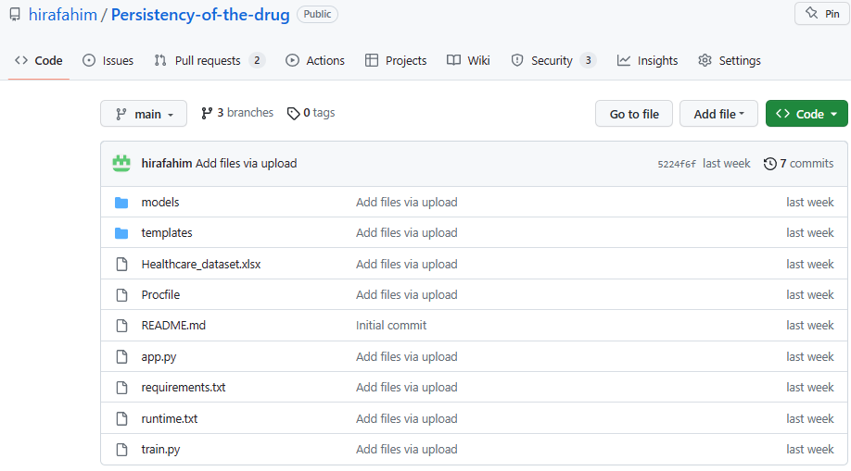
Model Deployment on Render (Open-Source Cloud Deployment)
After the model has been trained and deployed locally, now it is ready for deploy on open-source cloud “Render”.
Connect web service to GitHub Repository.
Click and open the application for persistency of the drug. https://persistency-of-the-drug.onrender.com
Hira Fahim

Slide 25
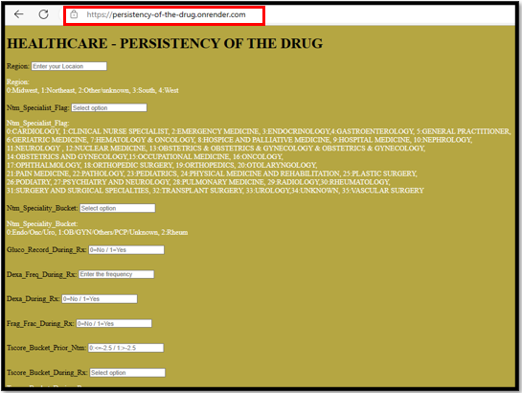
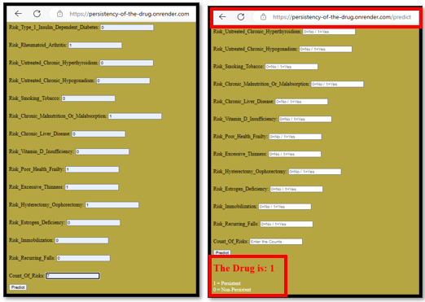
Model Deployment on Render (Open-Source Cloud Deployment)
Select categorical fields as per their respective number in the given code and click the Predict button. The predicted result will be displayed at the bottom of the web page.
Hira Fahim

Slide 26
Challenges
Feature selection was a challenging task, which is done by Chi2 from sklearn.feature_selection library.
Selection of best model was also tricky but after carefully considering all parameters and metrics of evaluation choose ‘K-Nearest Neighbor Classification model’ as the best model.
Hira Fahim

Slide 27
Thank You
Hira Fahim

